Slide 1
Pneumothorax segmentation using Deep Convolutional Networks
Team Members:
Aashish Chapain (THA075BCT002)
Ashok Budha (THA075BCT013)
Bibek Khanal (THA075BCT016)
Kapil Shrestha (THA075BCT022)
Department of Electronics and Computer Engineering
Thapathali Campus
4th of February, 2022

Slide 2
Presentation outlines
Motivation
Project Objectives
Project Scope
Project Applications
Methodology
Results
Analysis/ Discussion of Results
Remaining Tasks
References

Slide 3
Motivation
Pneumothorax is hard to diagnose and fatal health condition.
Failure in treating enlarging pneumothorax can result in death.
Primary method of diagnosis is chest X-ray imaging.
Even best of medical professionals find it difficult to diagnose.
Our project will help to effectively segment affected part.
Thereby, largely helping the diagnosis and treatment procedure.

Slide 4
Project Objectives
To classify the Pneumothorax affected X-rays with high accuracy.
To segment the affected part from the given X-ray images.
To provide intuitive UI for classifying and segmenting provided X-rays.

Slide 5
Project Scope
Using AI for safe, effective and efficient diagnose of diseases.
Project serves as an aid to diagnose pneumothorax.
Achieving a very high accuracy on pneumothorax segmentation task.
Target demographic includes medical professionals and medical companies.

Slide 6
Project Applications
Used by medical professionals to segment the affected part from X-ray.
Used by patients to find out affected part in absence of expert.

Slide 7
Methodology
Data Collection
Data Processing
Applied Architecture (U-Net++)
Testing Further Architectures (ResNet50 and U-net)
Hyperparameter Tuning
Model Evaluation
Metrics Comparison

Slide 8
Data Sources
Primary Method
  No primary sources of data collection were used.
Secondary Method
  The data set of pneumothorax affected X-rays were obtained from SIIM(Society for Imaging Informatics in Medicine) website which was hosted in Kaggle.com.

Slide 9
Data Augmentation
Data augmentation is a technique for increasing data amount.
Adding slightly modified copies of already existing data.
The techniques used for data augmentation are: -
  Central Cropping ,Random Brightness and Random contrast
  Random hue and Random saturation
  Flip up-down and flip left right

Slide 10
Balancing The Dataset
Dataset consisted of 12,400 pneumothorax affected and unaffected
It was further divided into training sets, validation set and test set.
It consisted of about 2500 Pneumothorax affected X-rays and 9900 non-affected X-rays.

Slide 11
Balancing The Dataset
Due to this reason the dataset was highly imbalanced.
Further required several processes to balance the data.
For balancing, we randomly shuffled the unaffected x-rays.
Choose them in equal number with the affected ones (Pneumothorax affected X-rays).

Slide 12
Fully Convolutional Network
Networks which doesn’t consist of a fully connected layer.
Efficiently learns to make dense predictions for per-pixel tasks. [1]
It makes FCN suitable for tasks like semantic segmentation.
U-Net, U-Net++ and SegNet are some of the examples of FCN.

Slide 13
U-Net architecture
It was introduced by Ronneberger et.al. in 2015 A.D.
Proved itself exceptional in bio-medical image segmentation task.
Consists of contracting path and an expansive path.
Contracting path downsamples and expansive upsamples image.
Introduces skip connections which helps recover lost information.[2]

Slide 14
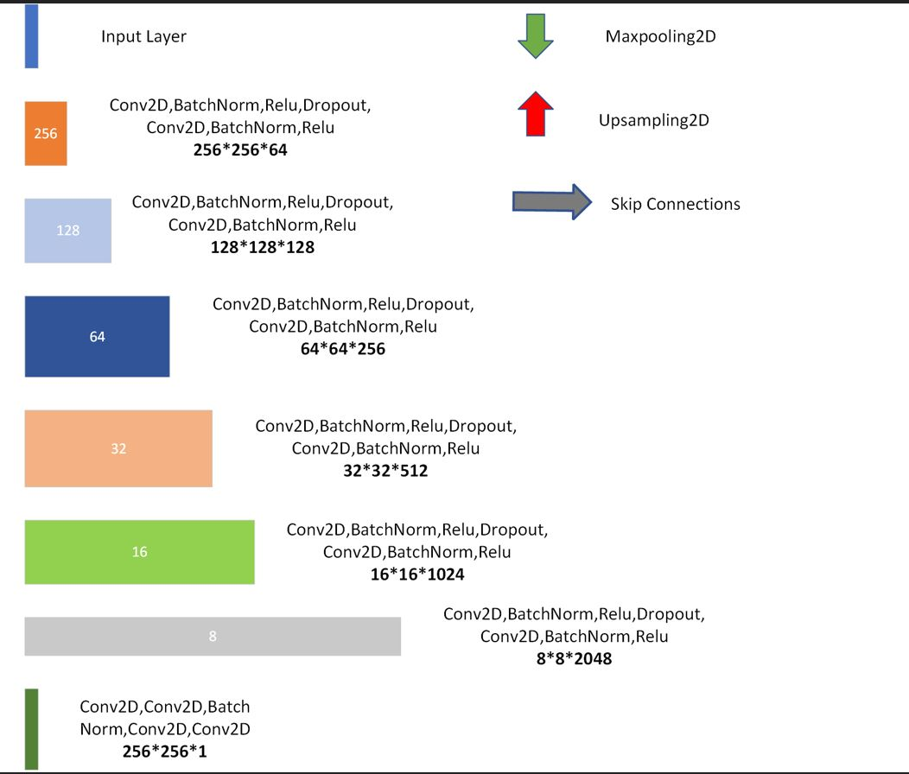
Representation of U-Net architecture legend

Slide 15
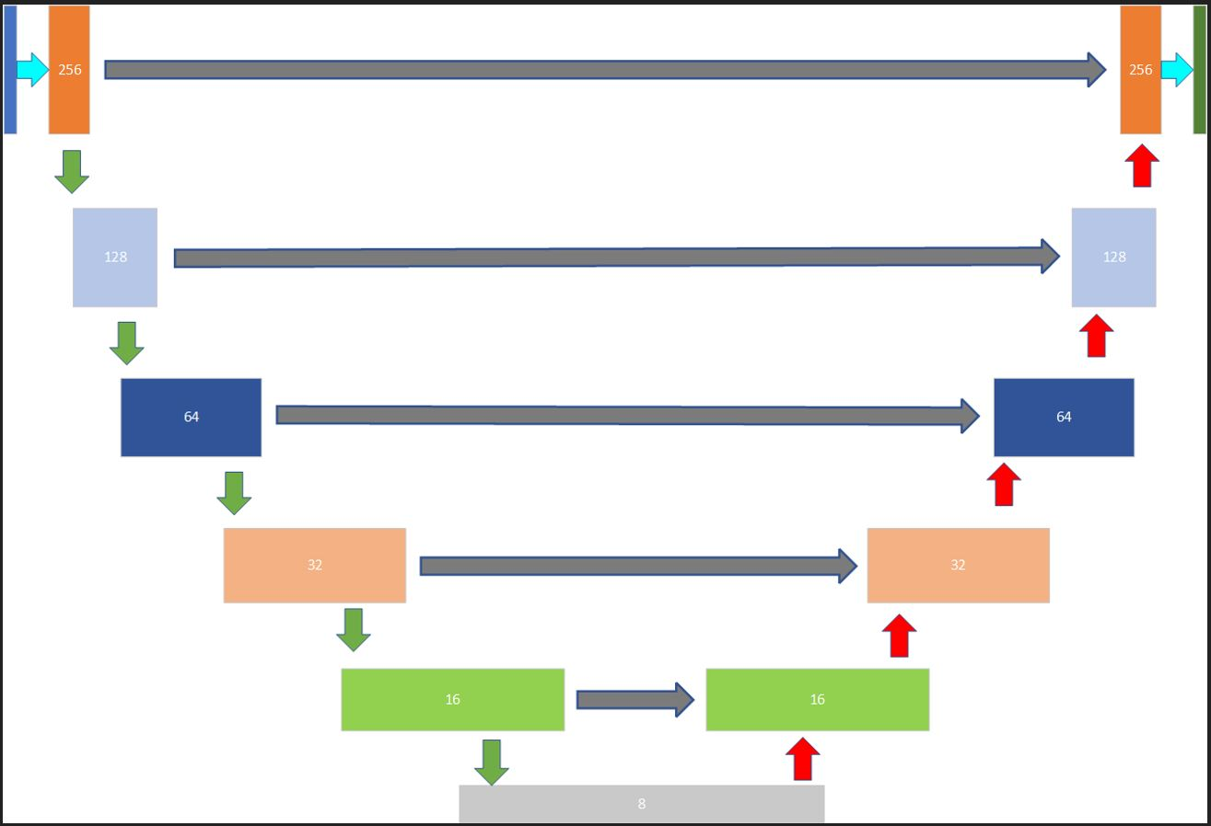
Representation of U-Net architecture

Slide 16
U-Net++ architecture
New and improved version of U-Net developed by Zhou et.al.
Popular choice for segmentation in biomedical field.
Builds on features of U-Net further improving segmentation accuracy.
U-Net++ differs from U-Net in terms of skip connections.
Improved skip connections effectively captures fine grained details. [3]

Slide 17
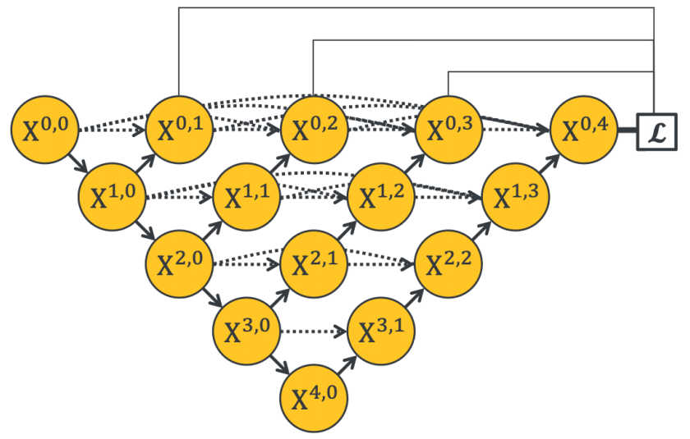
U-Net++ architecture
Fig. U-Net++ architecture representation [3]

Slide 18
Semantic Segmentation
It is task of assigning a class label to every pixel in image.
Termed as dense prediction, as prediction is done for each pixel.
It can be thought of classification of each pixel in an image.
It doesn’t differ across two different instances of the same object.

Slide 19
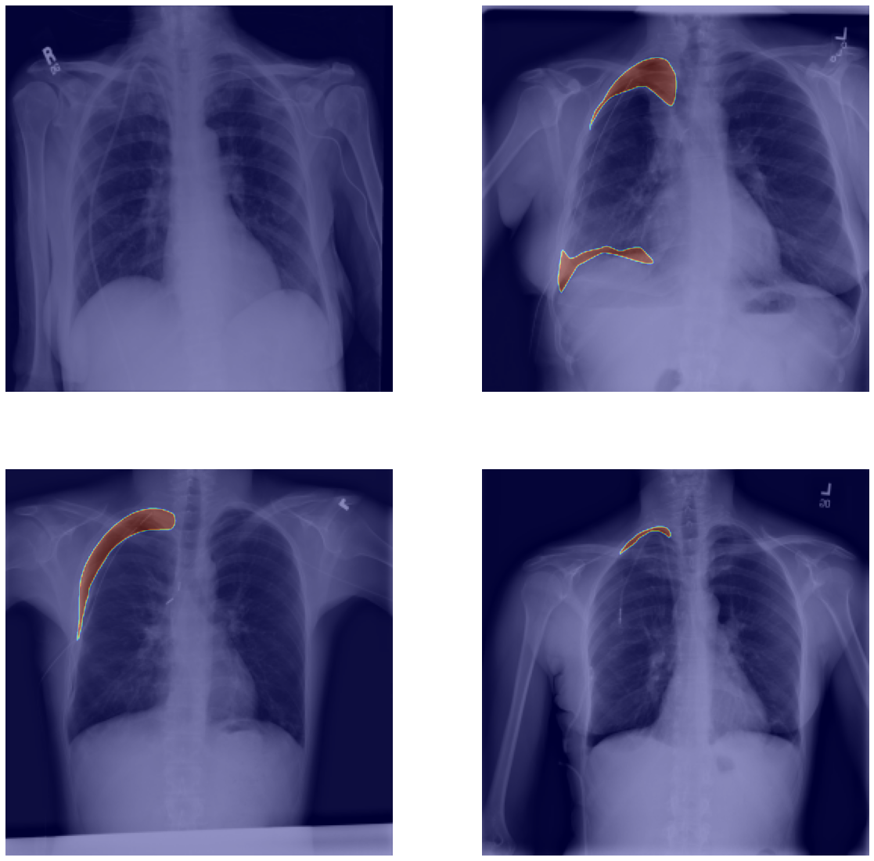
Semantic Segmentation

Slide 20
Evaluation Metrics
Evaluating a segmentation task is considered one of the hardest.
Pixel wise classification is involved.
It makes difficult to establish validation with ground truth value.
Some evaluation metrics are IoU,Dice coefficient and pixel accuracy.

Slide 21
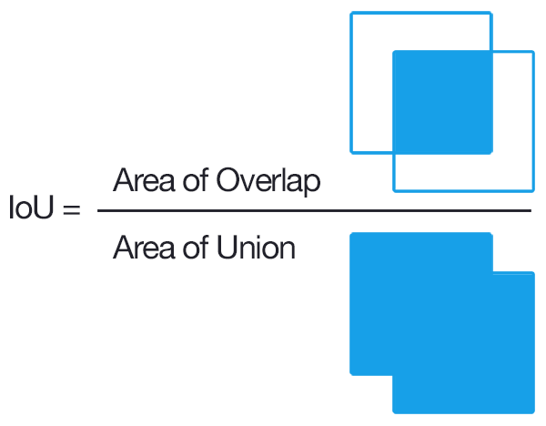
Evaluation Metrics
IoU is one of the widely used evaluation metric.
IoU quantifies percent overlap between target mask and prediction output.
We use IoU(Intersection over Union) which is given as :

Slide 22
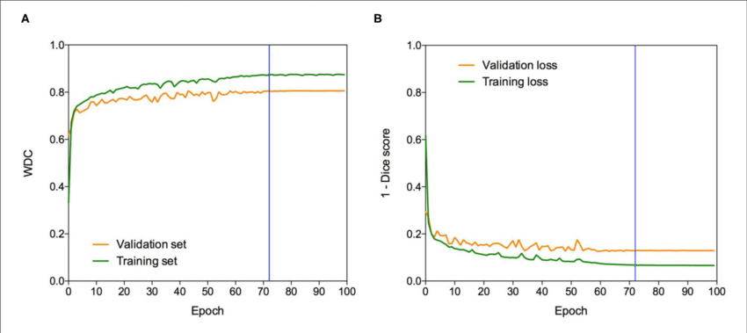
Plotting Of No. Of Epochs VS Loss

Slide 23
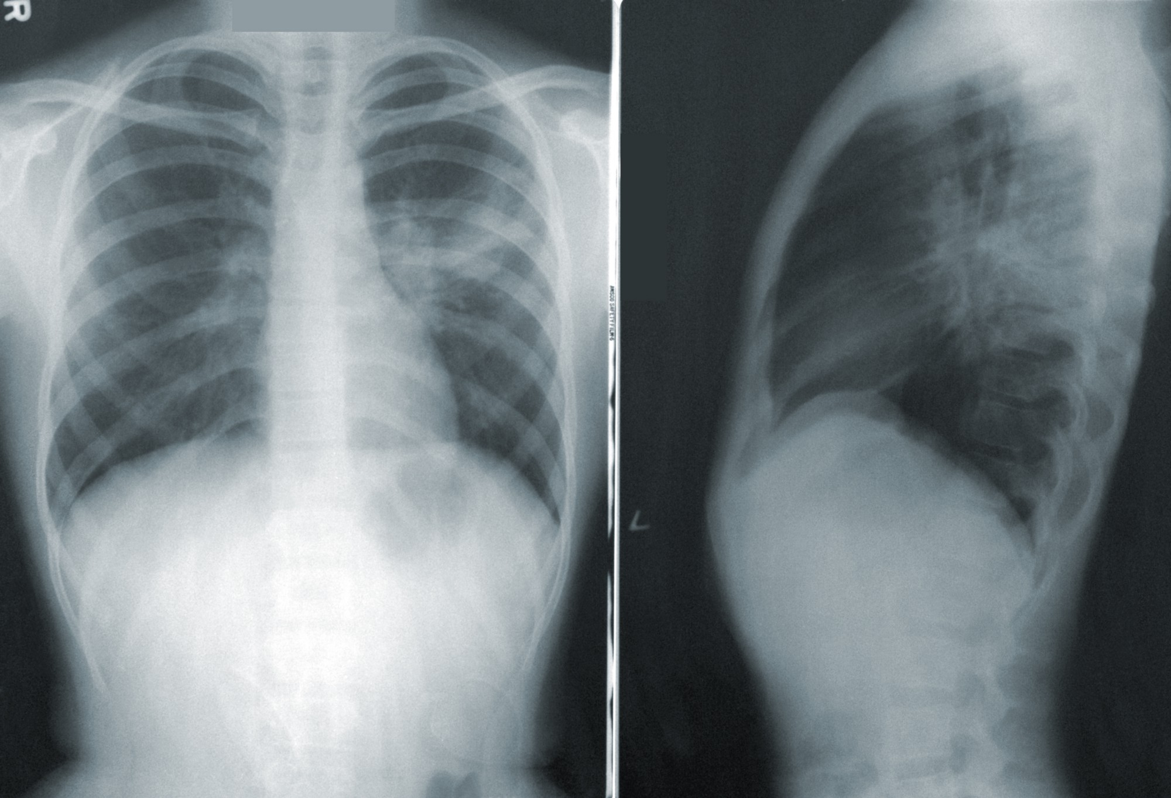
Results

Slide 24
Results

Slide 25
Analysis/Discussion of Results
The dice-metric has value of 0.35.
The value of dice-metric has been fairly low and needs to be fine tuned.
The plot of no. of epochs vs loss has been saturated at a point and has not been decreasing significantly.

Slide 26
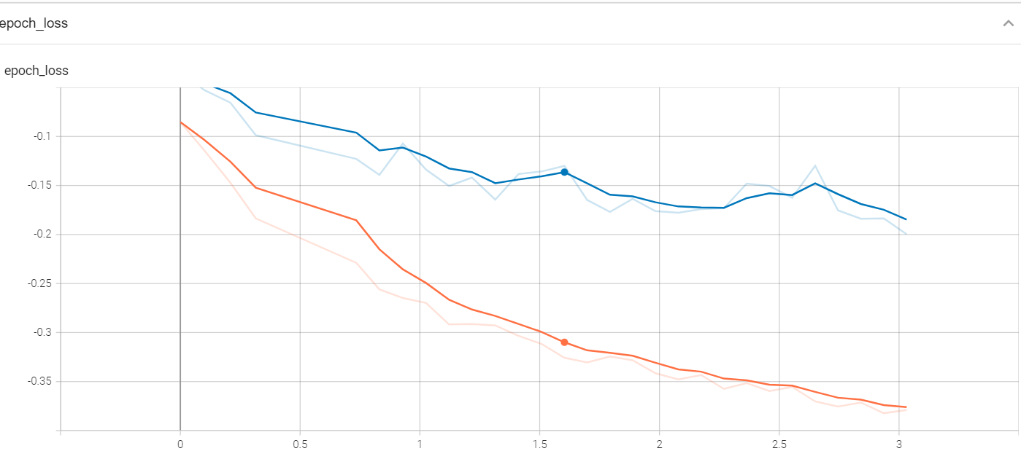
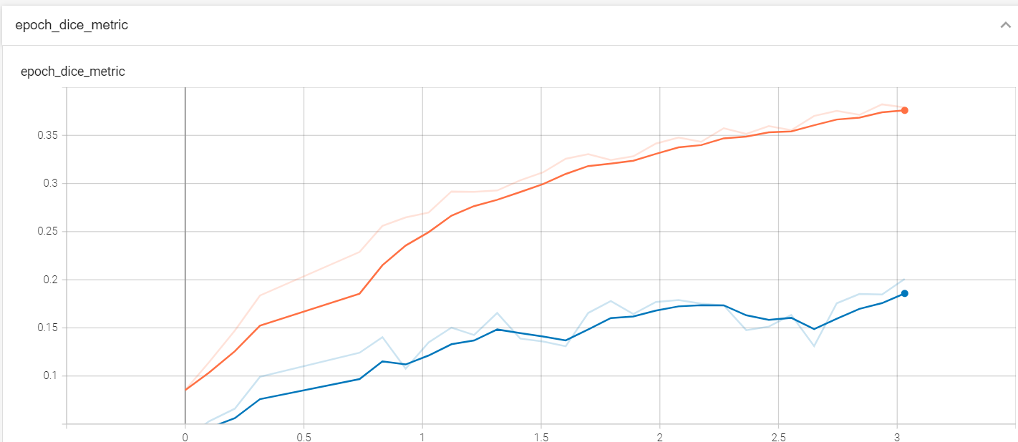
Epoch vs Loss
Epoch vs Dice-metric

Slide 27
Remaining Tasks
Classification of Pneumothorax affected X-ray is remaining.
The segmentation task has not been quite accurate yet.
The curve of no. of epochs vs loss has been saturated which needs to be decreased.

Slide 28
References
[1] J. Long, E. Shelhamer, and T. Darrell, “Fully convolutional networks for semantic segmentation,” 2015 IEEE Conference on Computer Vision and Pattern Recognition (CVPR), 2015.
[2] O. Ronneberger, “Invited talk: U-net convolutional networks for biomedical image segmentation,” Informatik aktuell, 2017.

Slide 29
References
[3] Z. Zhou, M. M. Rahman Siddiquee, N. Tajbakhsh, and J. Liang, “UNet++: A nested U-Net Architecture for Medical Image segmentation,” Deep Learning in Medical Image Analysis and Multimodal Learning for Clinical Decision Support, 2018.

